Slide 1
Validation of POLIMI chemical scheme reduction with ARCANE for CH4 and H2 combustion.
Antoine PESTRE
pestre@cerfacs.fr
Note : S151R2335 refers to the detailed mechanism
S24R148 refers to the skeletal mechanism S15R138QSS9 refers to the ARC mechanism
24/10/2020

Slide 2
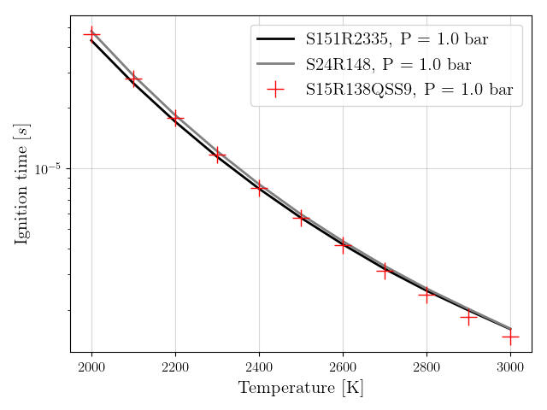
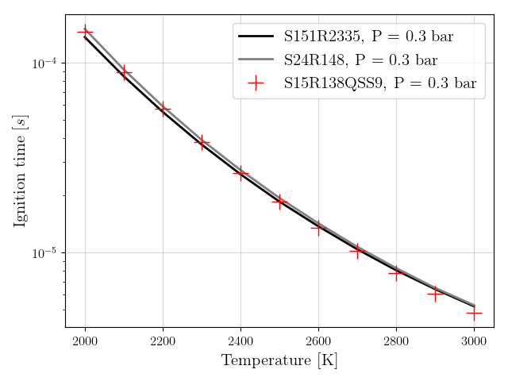
0D constant pressure reactors Auto ignition time : CH4-air
Auto ignition time at P = 1 bar
Auto ignition time at P = 0.3 bar

Slide 3
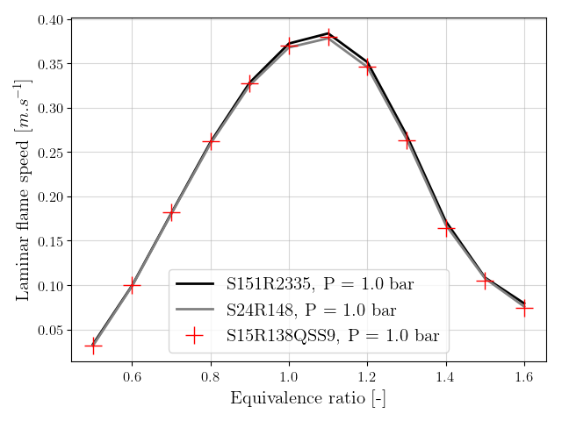
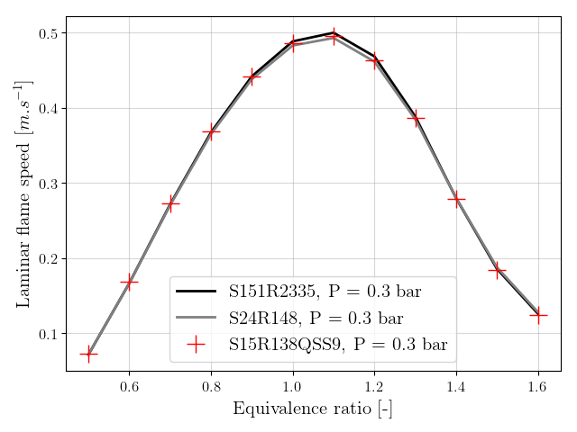
1D premixed flames Laminar flame speed : CH4-air at T = 300K
Laminar flame speed at P = 1 bar
Laminar flame speed at P = 0.3 bar

Slide 4
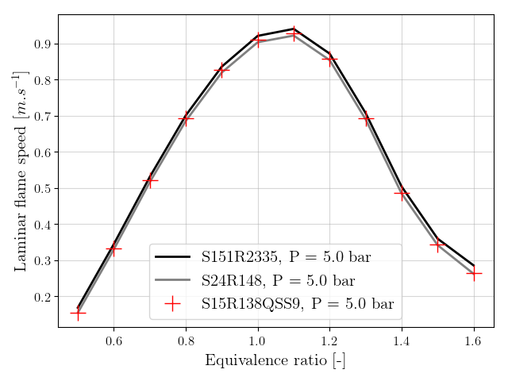
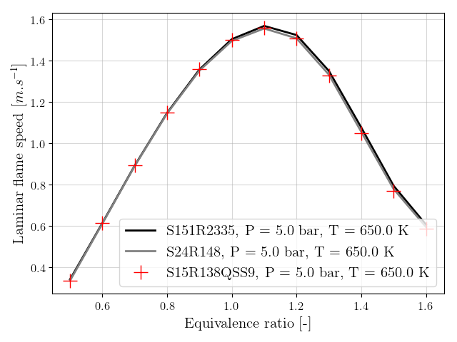
1D premixed flames Laminar flame speed : T = 650K, P = 5 bar
Laminar flame speed with fuel = 100%CH4
Laminar flame speed with fuel = 50%CH4 + 50%H2

Slide 5
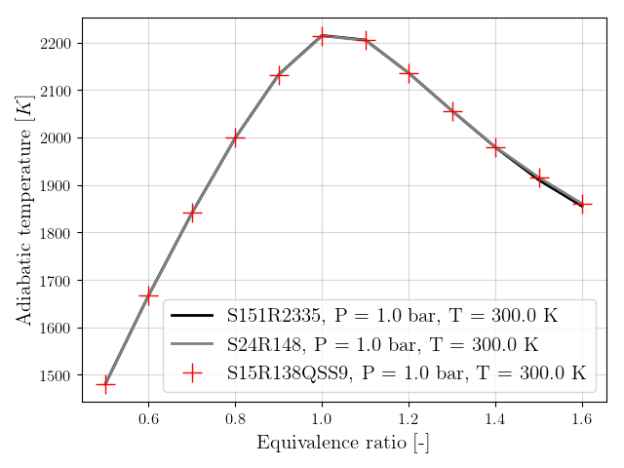
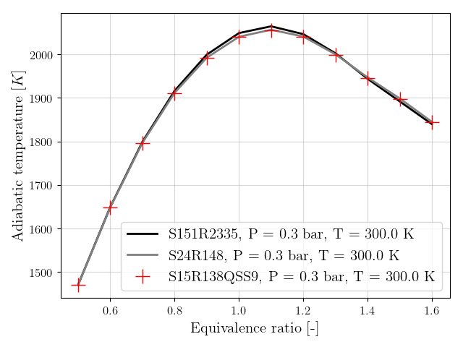
1D premixed flames Adiabatic temperature : CH4-air at T = 300K
Adiabatic temperature at P = 1 bar
Adiabatic temperature at P = 0.3 bar

Slide 6
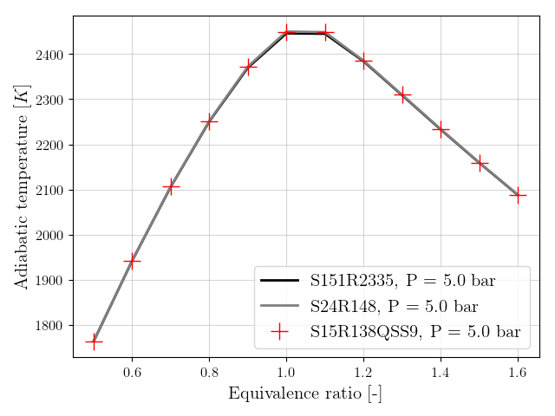
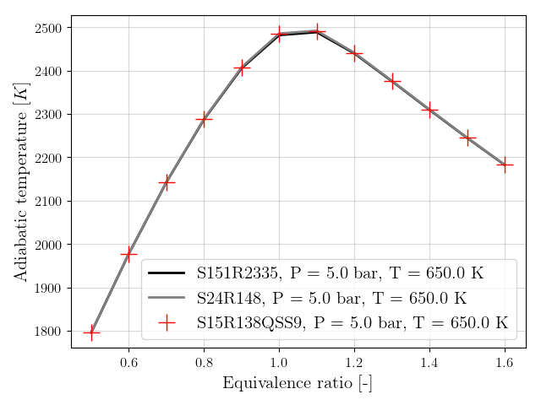
1D premixed flames Adiabatic temperature : T = 650K, P = 5 bar
Adiabatic temperature with fuel = 100%CH4
Adiabatic temperature with fuel = 50%CH4 + 50%H2

Slide 7
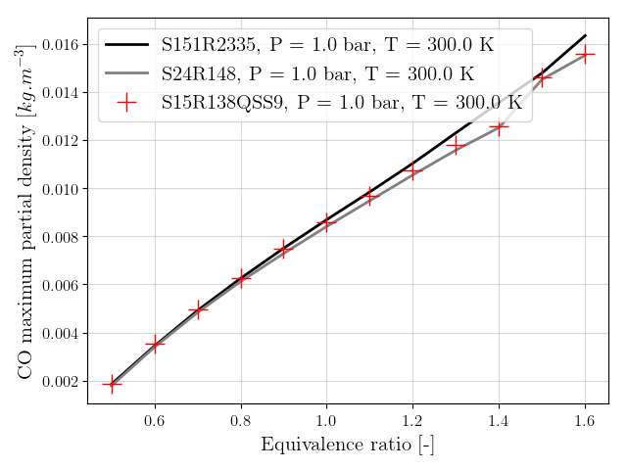
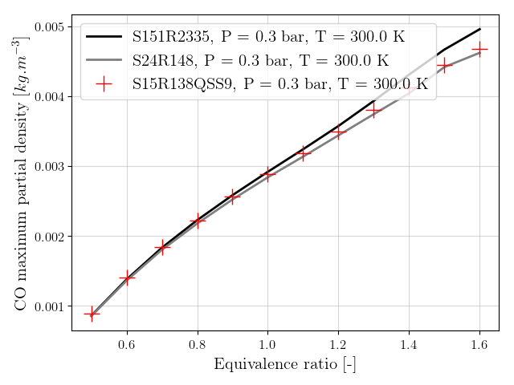
1D premixed flames Maximum CO partial density : CH4-air at T = 300K
Maximum CO partial density at P = 1 bar
Maximum CO partial density at P = 0.3 bar

Slide 8
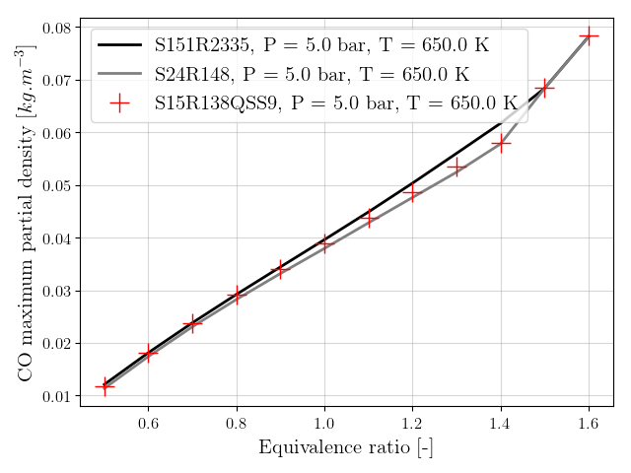
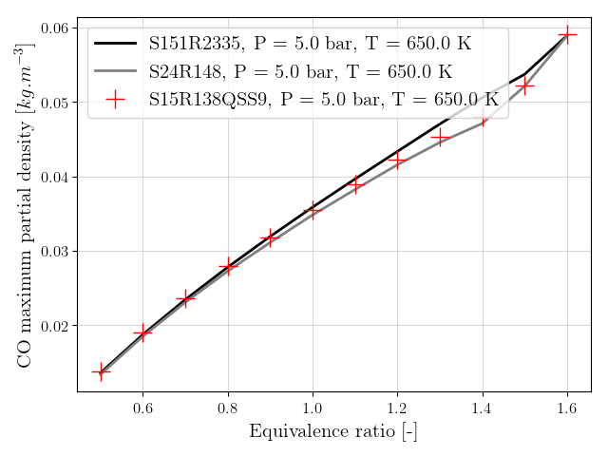
1D premixed flames Maximum CO partial density : T = 650K, P = 5 bar
Maximum CO partial density with fuel = 100%CH4
Maximum CO partial density with fuel = 50%CH4 + 50%H2

Slide 9
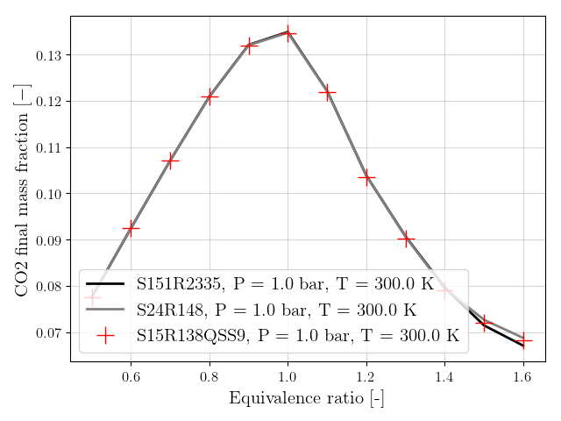
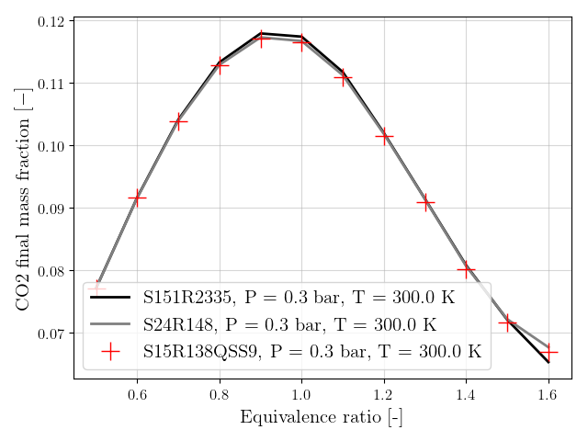
1D premixed flames Final CO2 mass fraction : CH4-air at T = 300K
Final CO2 mass fraction at P = 1 bar
Final CO2 mass fraction at P = 0.3 bar

Slide 10
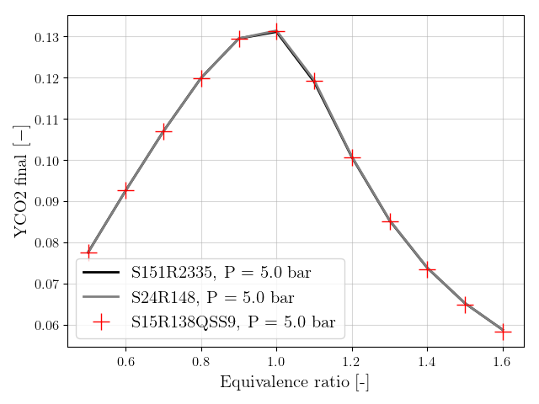
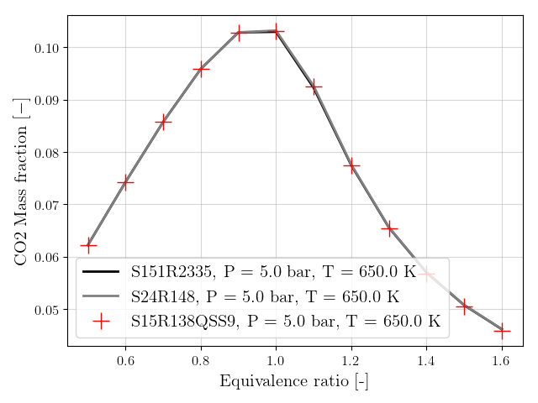
1D premixed flames Final CO2 mass fraction : T = 650K, P = 5 bar
Final CO2 mass fraction with fuel = 100%CH4
Final CO2 mass fraction with fuel = 50%CH4 + 50%H2

Slide 11
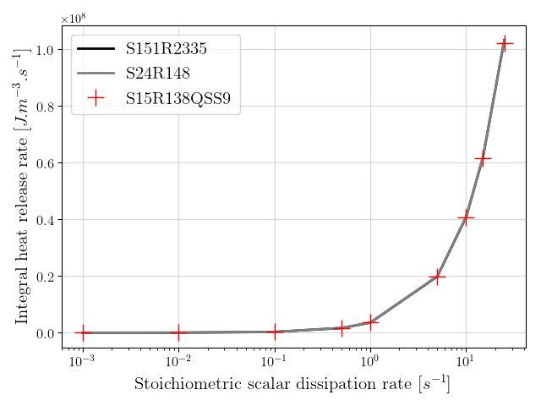
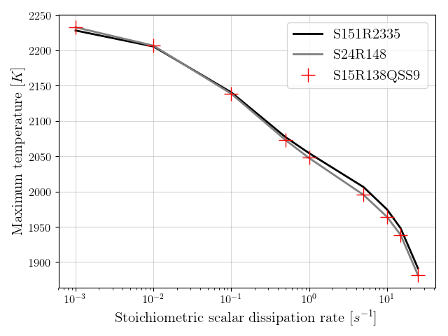
1D flamelets CH4-air at T = 300K, P = 1 bar
Integrated heat release rate
Maximum temperature

Slide 12
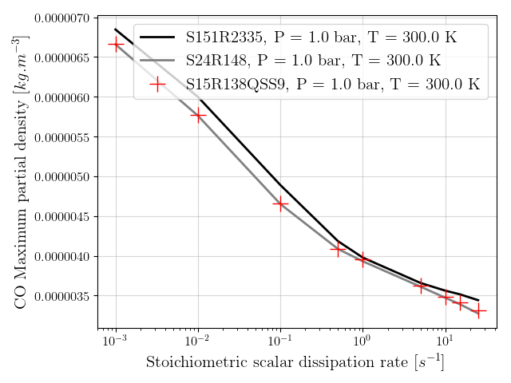
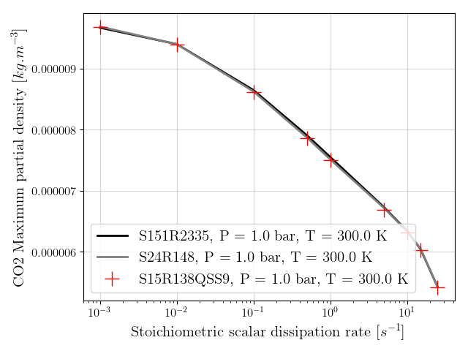
1D flamelets CH4-air at T = 300K, P = 1 bar
CO maximum partial density
CO2 maximum partial density

Slide 13
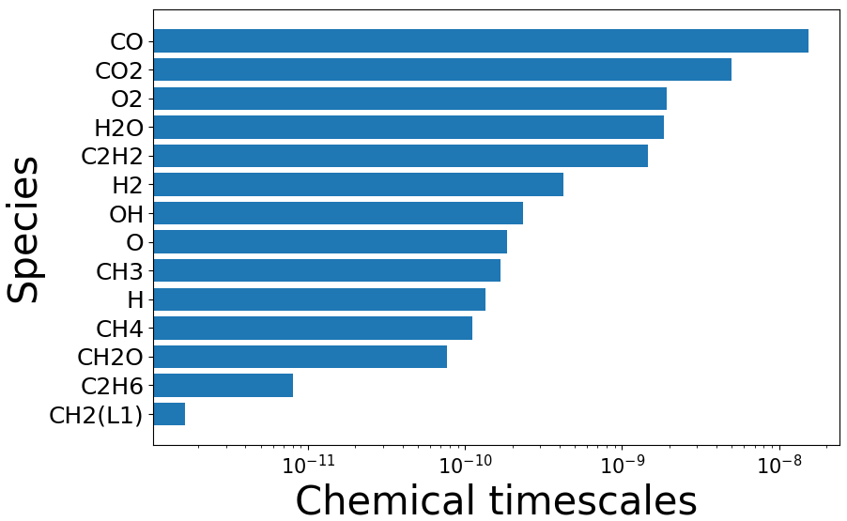
Chemical time-scales

